Slide 1
CarbonHub
An Intelligent Portfolio Optimization Tool Leveraging Machine Learning for Carbon-Conscious Investments
By: Devansh Shahane
Guide: Dr. Hemant Kasturiwale

Slide 2
Problem Statement
The Challenge in Sustainable Investing
Growing demand for sustainable investments and ESG integration.
Traditional portfolio optimization focuses only on risk & return, ignoring environmental impact.
Investors lack tools to:
Manual analysis is time-consuming, error-prone, and not scalable.
Optimize portfolios considering carbon footprint.
Integrate ESG metrics into decision-making.
Achieve multi-objective balance: returns, risk, and sustainability.

Slide 3
Objectives
Primary Goals
1
Develop an AI-powered tool
for portfolio optimization incorporating carbon footprint & ESG scores.
2
Integrate Machine Learning models
for return prediction and ESG impact analysis.
3
Enable multi-objective optimization
balancing:
Expected Return
Risk (Volatility)
Carbon Reduction
ESG Score Improvement
4
Provide visual dashboards
for allocation, efficient frontier, and performance comparison.
5
Enable scenario analysis
for different risk tolerances & carbon reduction targets.

Slide 4
Tools & Technologies
Programming Languages
Web / Dashboard Frameworks
Python (Backend, ML models)
Streamlit – Interactive dashboards
JavaScript (Frontend UI / Visualization)
Chart.js – Client-side charts
Machine Learning Libraries
Data Sources
Scikit-learn – Model training & evaluation
Historical stock prices (Yahoo Finance API)
Pandas / NumPy – Data processing
ESG data providers (MSCI, Refinitiv, etc.)
Matplotlib / Plotly – Visualization
Carbon footprint data from verified registries
PyPortfolioOpt – Portfolio optimization algorithms

Slide 5
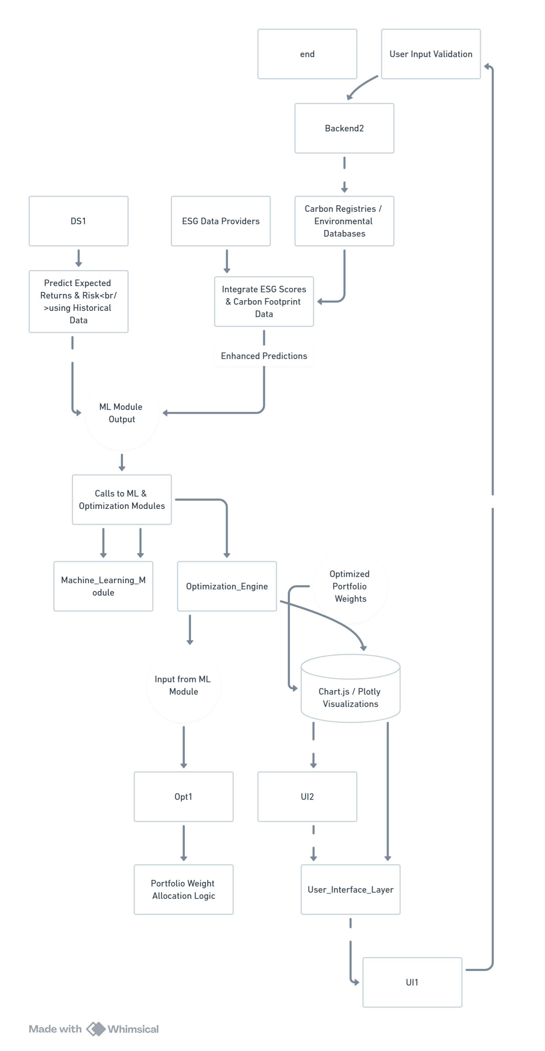
System Architecture Diagram
User Input Validation – Captures and verifies investment parameters: amount, risk tolerance, carbon target, ESG weight, and time horizon.
Data Sources
DS1: Historical financial data for price, return, and risk analysis.
ESG Data Providers: ESG scores from verified agencies.
Carbon Registries / Environmental Databases: Carbon footprint metrics for assets.
Data Integration & Preprocessing – Merges financial, ESG, and carbon data to enhance prediction accuracy.
ML Module – Predicts expected returns and volatility using historical data and enhanced ESG-carbon metrics.
Optimization Engine – Applies multi-objective optimization to balance return, risk, ESG score, and carbon reduction.
Portfolio Weight Allocation – Determines optimal asset weights for the investment portfolio.
Visualization Layer – Uses Chart.js / Plotly for displaying allocation, efficient frontier, and performance comparison.
User Interaction Loop – Allows users to review results, adjust parameters, and re-run optimization until satisfied.

Slide 6
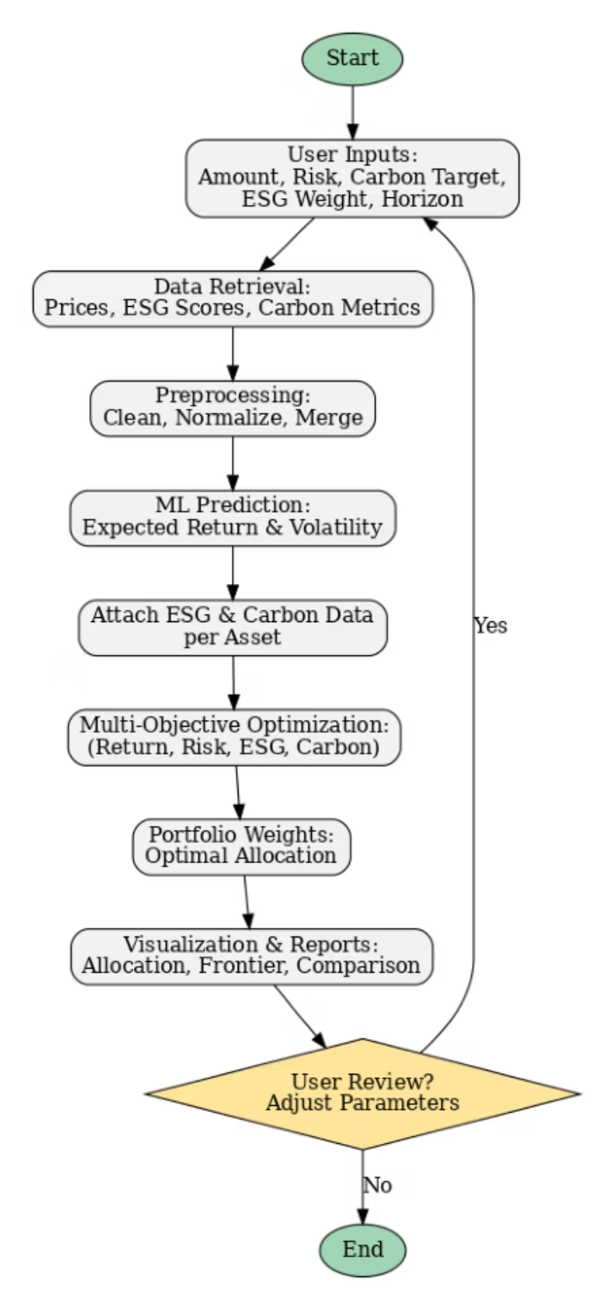
Workflow Diagram
User Inputs – Investment amount, risk tolerance, carbon reduction target, ESG weight, and investment horizon.
Data Retrieval – Collects asset prices, ESG scores, and carbon metrics from financial datasets.
Preprocessing – Cleans, normalizes, and merges data to prepare it for analysis.
ML Prediction – Estimates expected return and volatility for each asset using machine learning models.
Attach ESG & Carbon Data – Links environmental and carbon footprint data to each asset.
Multi-Objective Optimization – Balances return, risk, ESG score, and carbon reduction goals.
Portfolio Weights – Determines the optimal allocation for the portfolio.
Visualization & Reports – Displays allocations, efficient frontier, and portfolio comparison.
User Review Loop – Allows parameter adjustments for re-optimization before finalizing.

Slide 7
Module Division (Phase-wise Breakdown)
Phase 1
Onboarding & Risk Profiling
User registration, financial goal setting, and assessment of risk tolerance.
Phase 2
Data Integration (Market + Sentiment APIs)
Gathering historical market data, ESG scores, carbon footprint metrics, and sentiment data from various APIs.
Phase 3
Portfolio Recommendation Engine
Development and implementation of ML models for return prediction and multi-objective optimization.
Phase 4
Virtual Trading & SIP Simulation
Enabling users to simulate investment strategies and analyze performance in a risk-free environment.
Phase 5
Explainability Layer for Recommendations
Building a transparent system to show the reasoning behind portfolio suggestions.
Phase 6
Testing, Operations & Deployment
Rigorous testing, infrastructure setup, and deployment of the CarbonOpti tool.

Slide 8
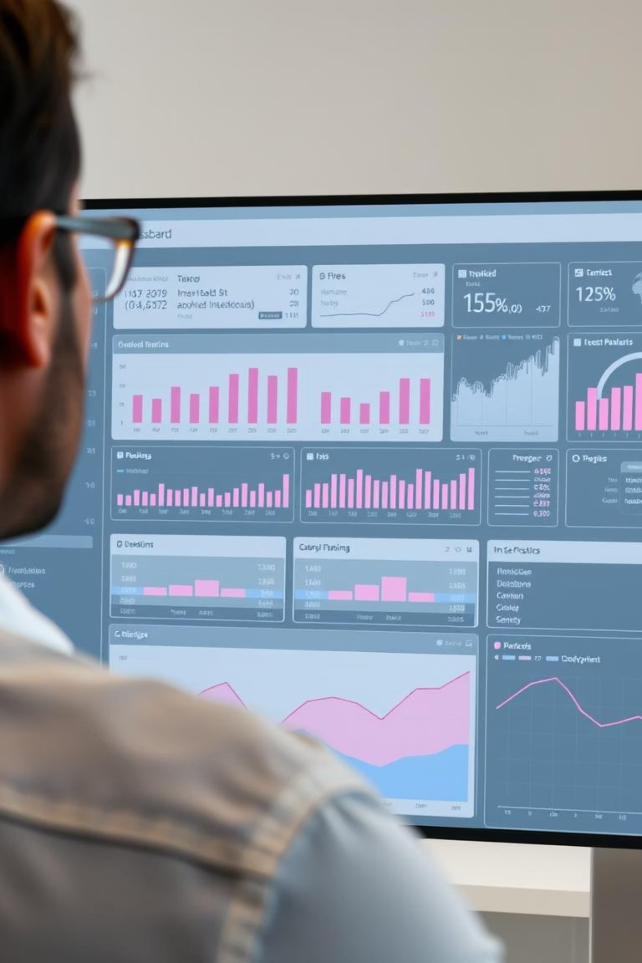
Expected Outcomes
Improved investment decisions
with environmental impact awareness.
Achieve balanced portfolios
meeting return and carbon reduction goals.
Provide clear, interactive visualizations
for investors.
Scalable and adaptable
to different asset classes and geographies.

Slide 9



Conclusion
Combines AI + Sustainable Finance
Addresses both financial performance
Potential for future expansion
for next-generation investment tools.
and climate responsibility.
into blockchain-based carbon credit integration or automated ESG scoring.

